Slide 1
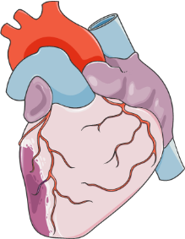
Resolving
SPMs
LOXs
Splenocardiac
concert
MI
Resolution and inflammation
Spleen
+
Clodronate
LOXs
Monocyte
Macrophage
SPMs
Non-Resolving
Time
Science Signaling 2018

Slide 2
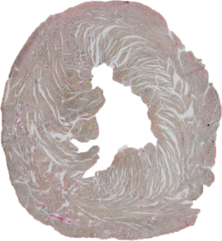
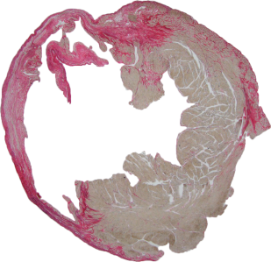
Control Heart
Chronic Heart Failure
Am. J. Physiol. Heart Circ. Physiol. 2018

Slide 3
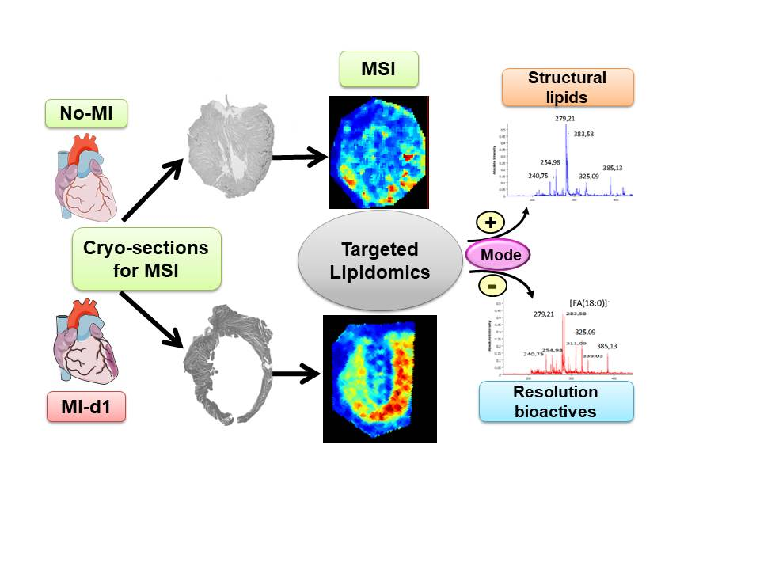
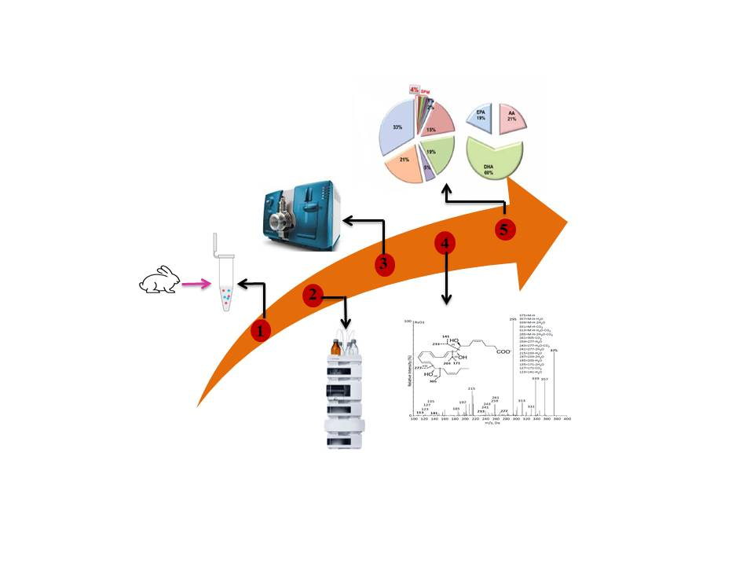
Anal. Bioanal.
Chem.2018
Targeted
Lipidomics

Slide 4
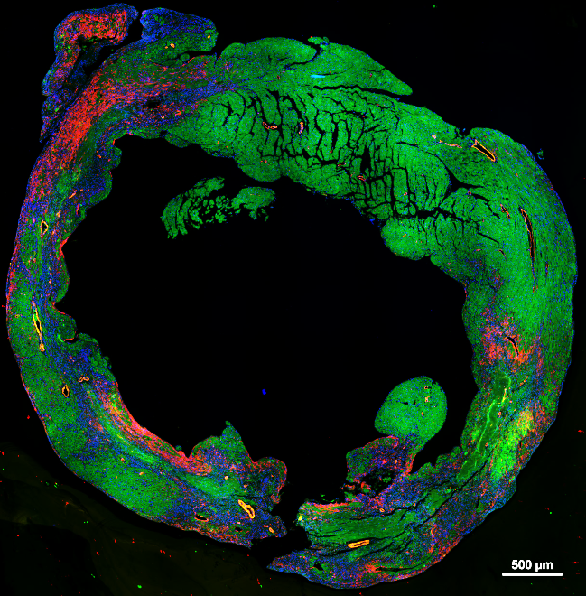
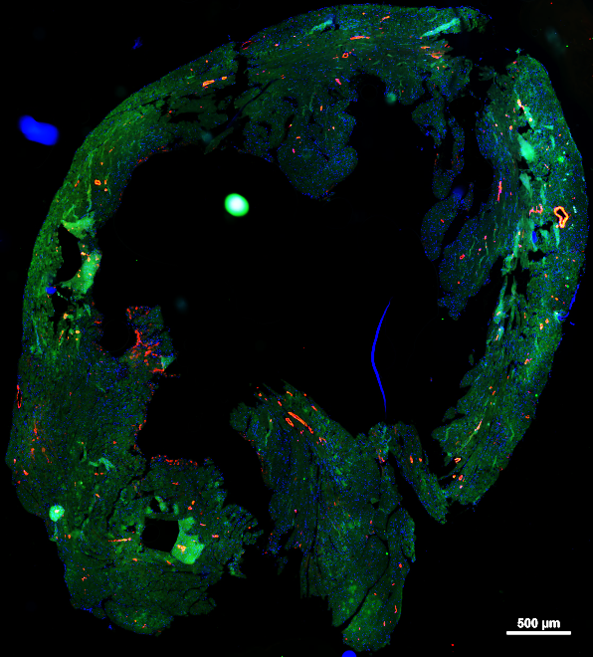
Male
Female
J. Am. Heart Assoc. 2020

Slide 5
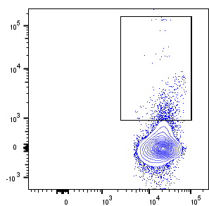
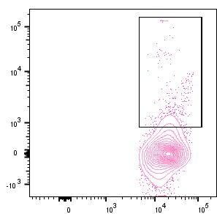
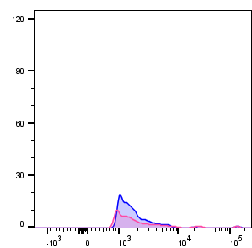
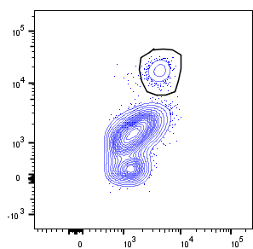
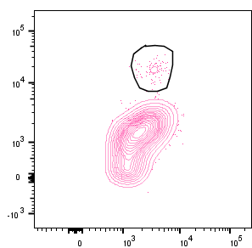
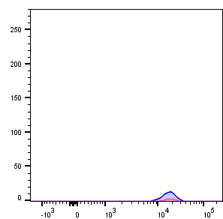
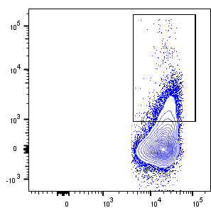
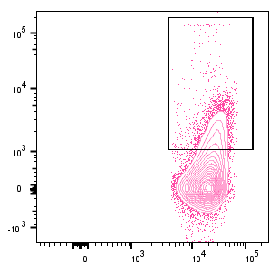
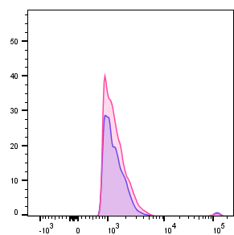
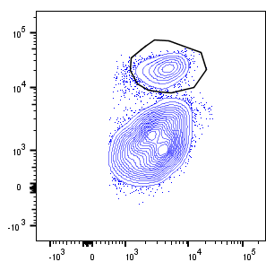
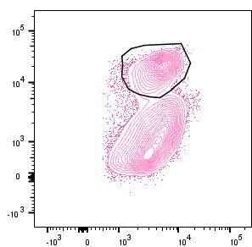
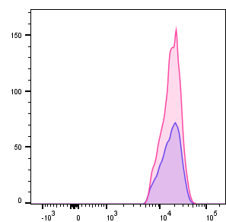
CD45⁺/CD11c⁺
CD45⁺/CD11b⁺/ Ly6G⁺
CD11c⁺
Male
Female
CD11c
Ly6G⁺
Male
Female
Ly6G
Male
0.36 %
0.70%
Female
0.30%
0.28%
No-MI
1.88%
4.77%
4.80%
9.17%
MI-d1
CD45⁺
CD11b⁺
J. Am. Heart Assoc. 2020

Slide 6
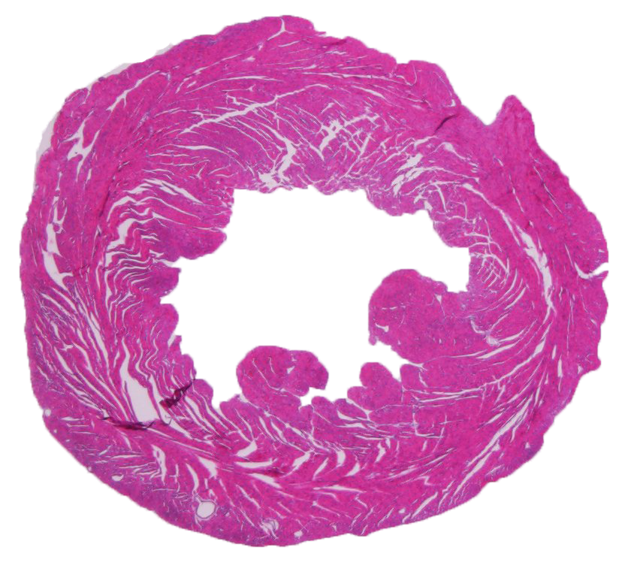
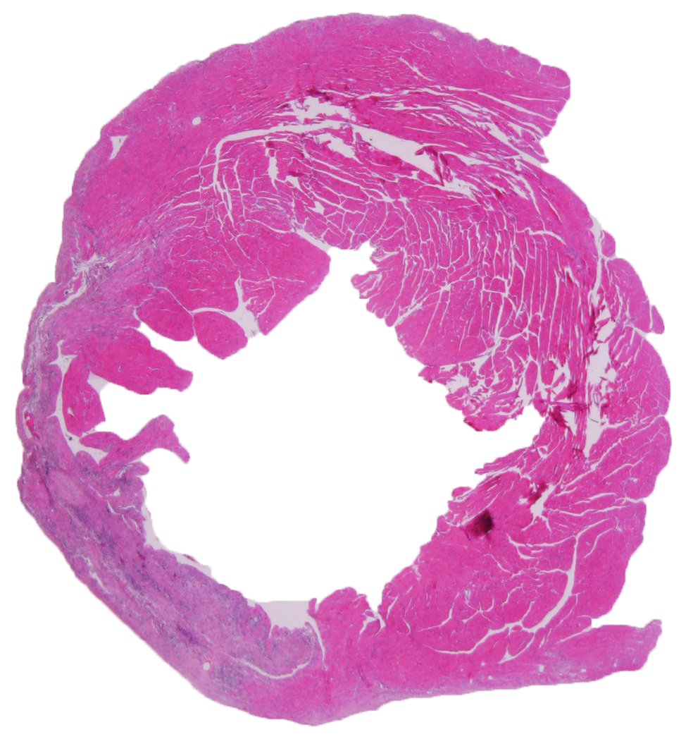
Control Heart
Chronic Heart Failure
J. Am. Heart Assoc. 2020

Slide 7
Cardiosplenic and Cardiorenal Network in Aging
Young and Aging
Balanced omega 6 intake
Young and Aging
Excessive
omega 6 intake
Lean aging
Obesity, dyslipidemia, hyperglycemia
Myocardial infarction
↑ 5-, 12-, 15-LOXs
↑ D- Resolvins- RvD1 & RvD5
↑ E- Resolvin - RvE3
↓ TNF-α
5-, 12-, 15-LOXs
D- Resolvins RvD1&RvD5
E- Resolvin - RvE3
TNF-α
Resolving / non-resolving
inflammation
↑ Inflammation
(↑Ly6C^{hi,} CD11b^{low}/F4/80^{high})
Inflammation
(↓Ly6C^{hi}, CD11b^{low}/F4/80^{high})
Cardiosplenic and Cardiorenal Network
Failure
Aging 2016

Slide 8
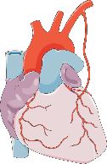

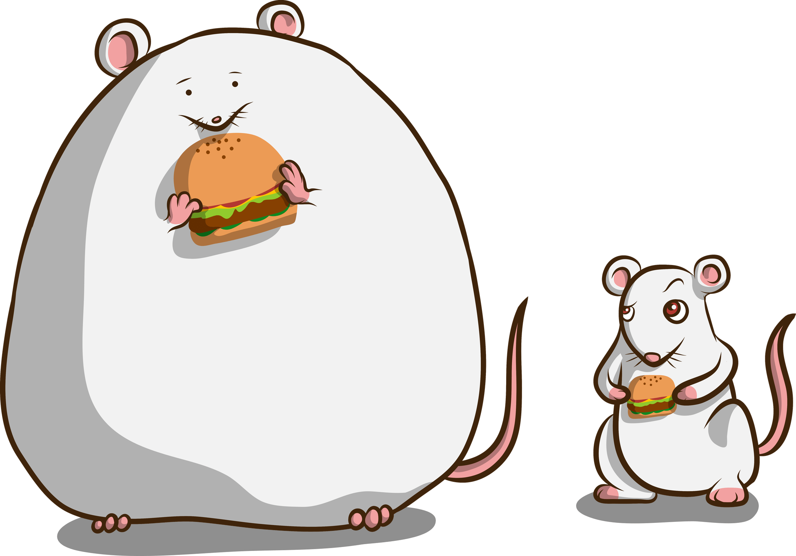

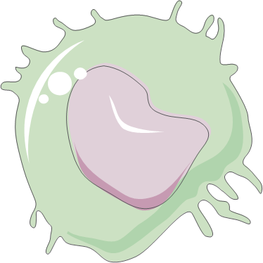
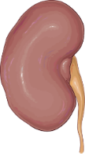

Leukocyte dysregulation
heart
spleen
CD31, eNOS
Inflammation
ALX^{-/-}
ALX^{-/-}
Ly6C^{high} CCR2⁺
Obesity + Age = HFpEF
2 months
Food intake
Fat mass
4 months
CD31, eNOS
Adipose tissue
Cardiorenal inflammation
kidney
Obesogenic aging
Fed. of Am. Soc. for Exp. Bio. 2020

Slide 9
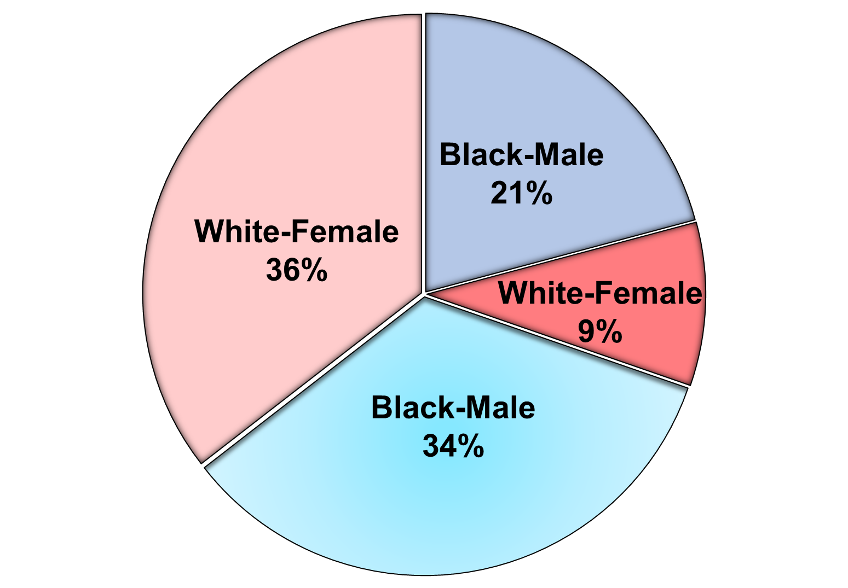
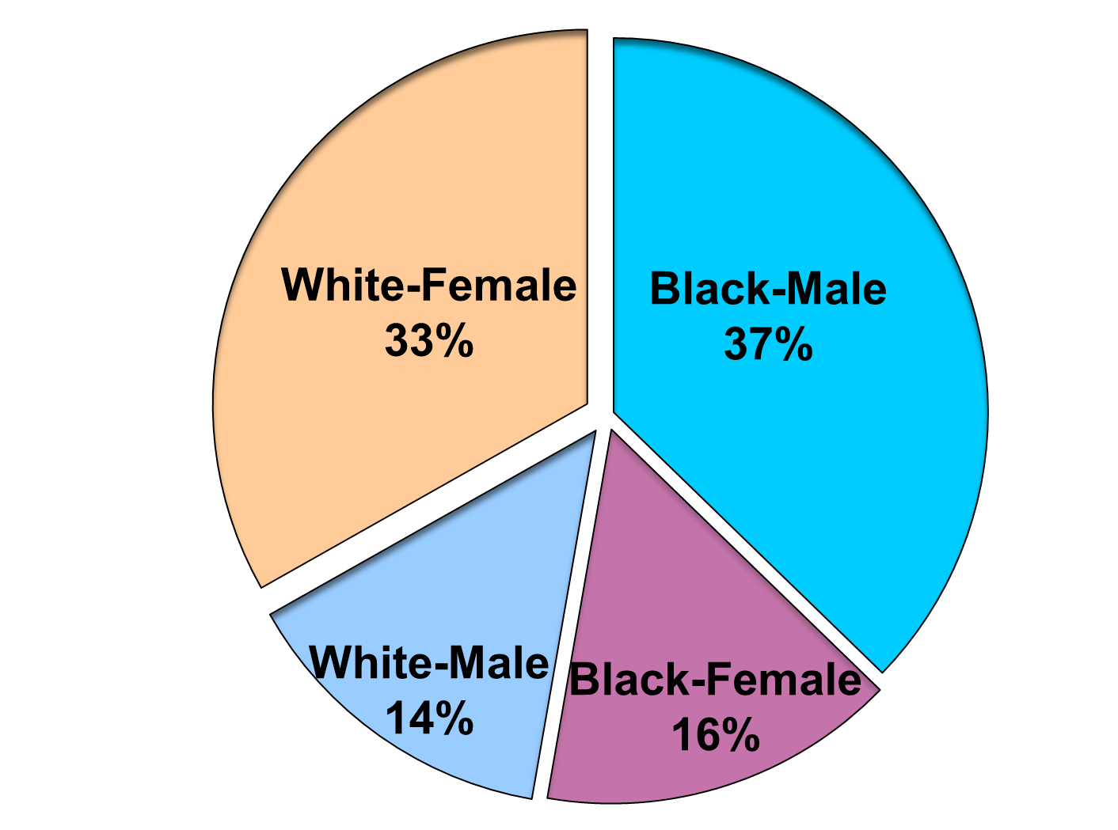
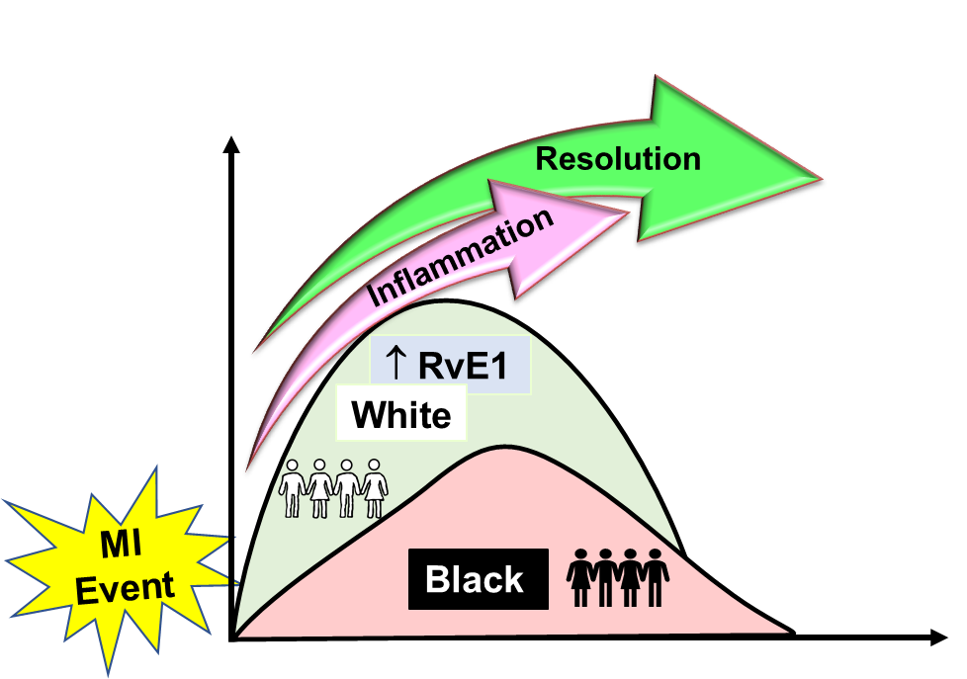
Resolvin E1
Protectin D1
Black-Male
Black-Female
White-Male
White-Female
Eur. Heart J. 2020

Slide 10

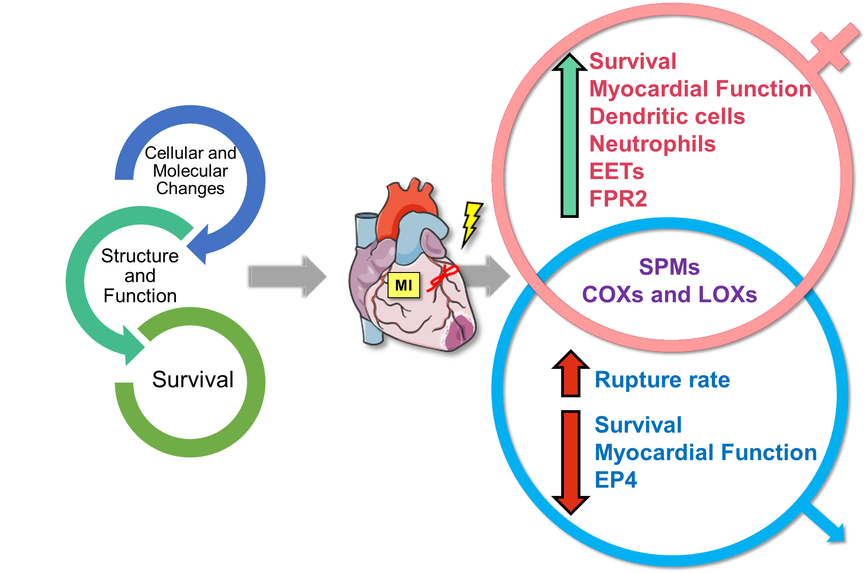

J. Am. Heart Assoc. 2020

Slide 11
Phagocytosis
Knockout
Apoptosis
Cell
Growth
Aging
Myocardial Infarction
Inflammation
Diet
Profile
Vitro
Switch
Patient
Obesity
Molecule
Specialized Proresolving Mediators
Leukocyte
Regeneration
Aorta
Cardiac Repair
Gene Expression
Lipidomics
Disease
Adhesion
Function
Efferocytosis
Fatty Acid
Cardiac Injury
Resolution
Healthy
Fate
Cycloxygenase
Myofibroblast
Treatment
Atherosclerosis
Precursor
Mechanism
Homeostasis
Receptors
Metabolic
Angiogenesis
Immune Response
Damage
Cellular
Vessel
Non Resolving Inflammation
Spleen
Myopathy
Fibrosis
Recovery
Angiogenesis
Heart Failure
Left Ventricle
Lipoxygenase
Pathway
Fatigue
Mouse
Progenitor
Myositis
Macrophage
Antibody
Markers
Fatigue
Lipid Signaling

Slide 12
